Slide 2
Using .NET and Azure to Build & Deploy Microservices Architectures
Aka : Evolutionary Architectures
Alberto Acerbis

Slide 3


Scenario
Sales
Warehouse

Slide 4

The lowest level of knowledge is when we make a lot of decisions about the future system
Microservices
Serverless
Monolithic
SOA
It’s easy to make things complicated, but it’s complicated to make them simple
EDA

Slide 5
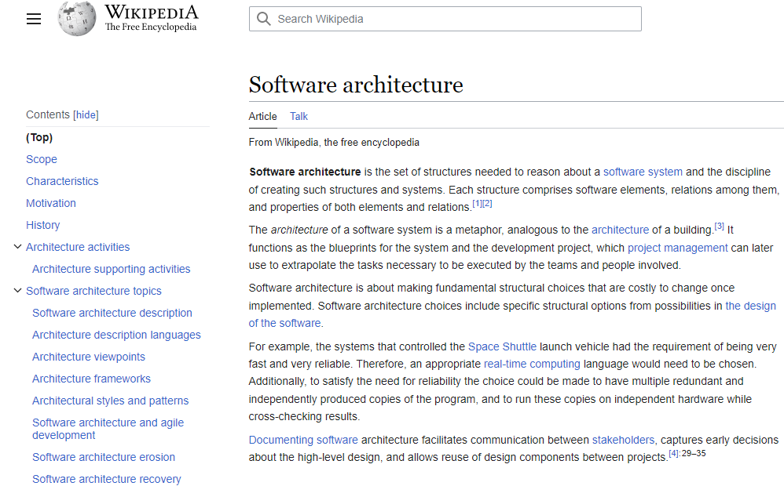
Software Architecture

Slide 6
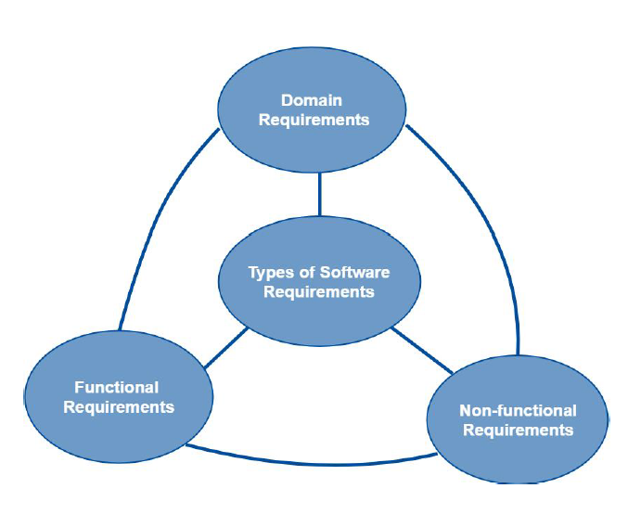
Software Architecture
Functional requirements, aka Business Requirements
Non-functional requirements, aka Technical Requirements
Domain requirements, aka Industry Standard Requirements

Slide 7
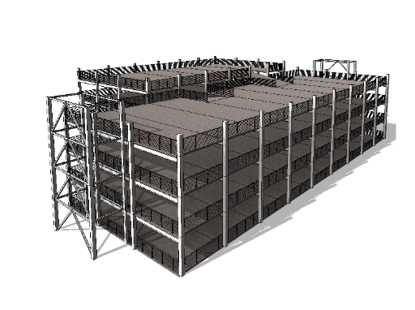
One Upon a Time

Slide 8

Risk comes from not knowing what you are doing
(Warren Buffet)
The only way to decrease ignorance is to increase understanding

Slide 9
New Vision
Regular changes to the requirements have become part of normal business evolution
From architectures as an up-front challenge to a continuous challenge
Changes keep coming so development never ends and the so architecture will keep changing

Slide 10
Software Rot
Is either a slow deterioration of software quality over time or its diminishing responsiveness that will evenutally lead to software becoming faulty, unusuble, or in need of upgrade.

Slide 11
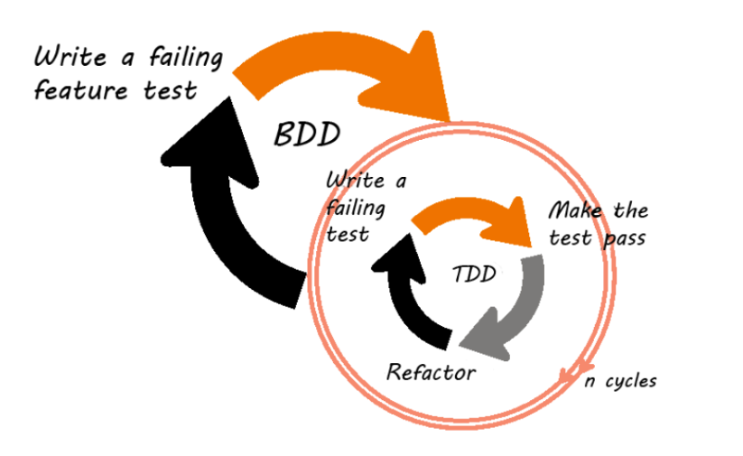
Evolutionary Software

Slide 12
Evolutionary Architecture

Slide 13
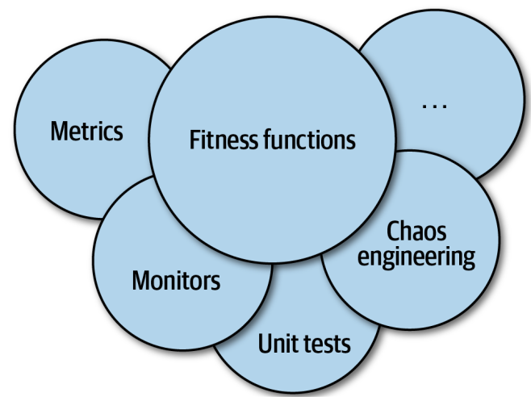

Slide 14
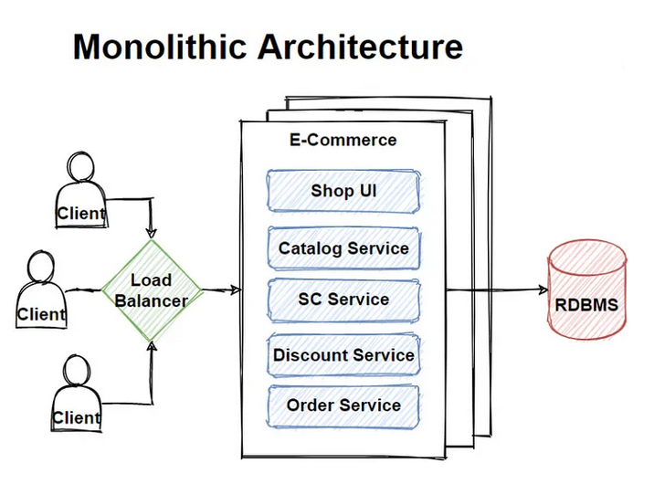
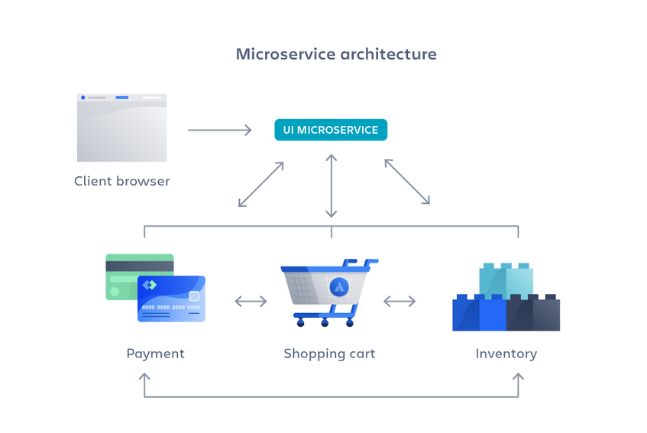
Monolithic
Microservices

Slide 15
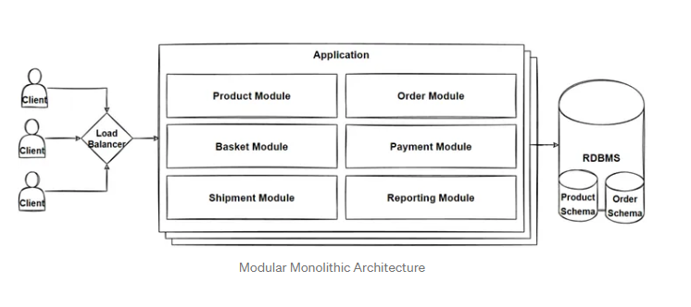
Modular Monolith Architecture
Increased productivity
Ease of creating new modules
Simplicity of debugging
Ability to convert to microservices
Improved team collaborations
A less complex architecture compared to microservices
A cohesive and loosely coupled system
The option to use different databases

Slide 16
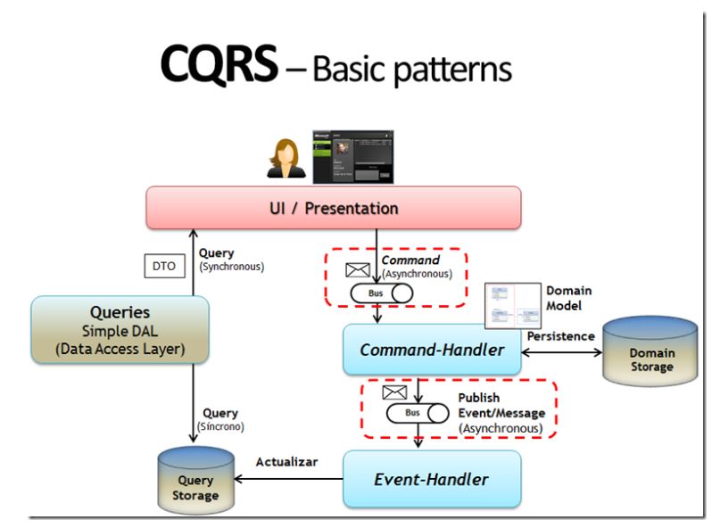
Event-Driven and CQRS Pattern
Microsoft DevBlogs

Slide 17
Sales
Warehouse
Launch New Order
Ask Beers Availability
Beers Availability Checked
Beers
Withdrawal
Beers
Withdrawal
Add Order

Slide 18


Slide 19
Azure AppService provides fully managed hosting for web applications including websites and web APIs
AKS
Azure Kubernetes Service (AKS) provides a fully managed Kubernetes option in Azure
App Service
Container App
Azure Container Apps enables you to build serverless services based on containers

Slide 21
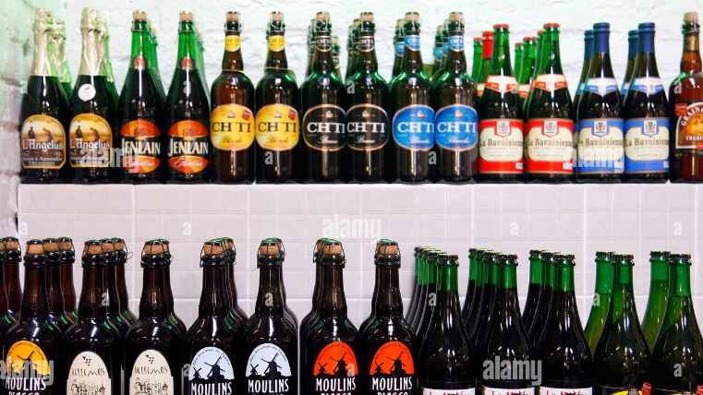

Slide 22
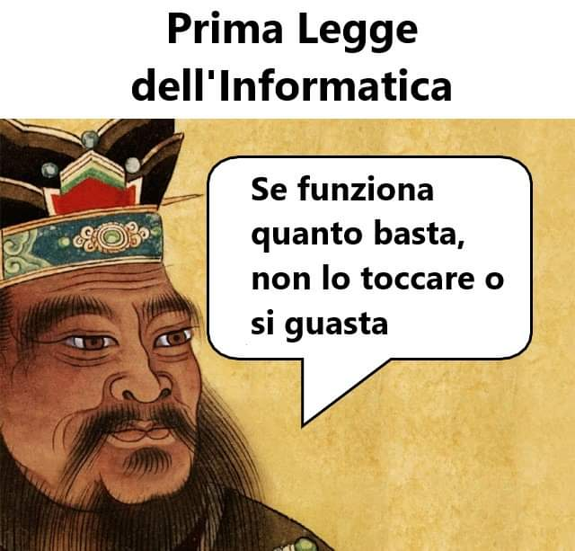

Slide 24
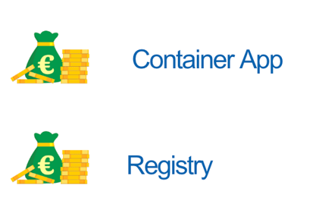
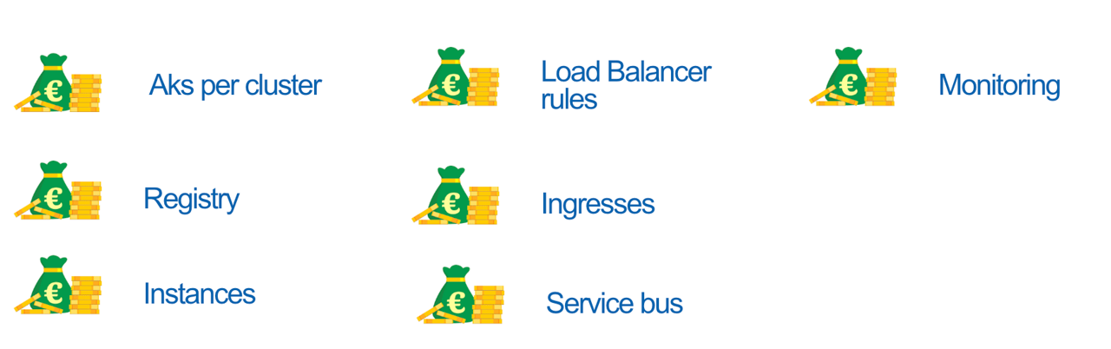
A matter of cost

Slide 25
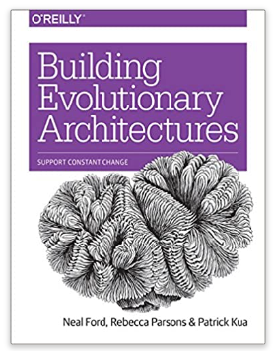
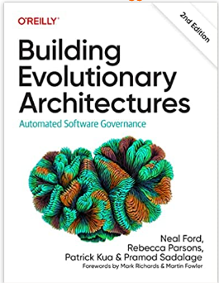
Evolutionary Architecture

Slide 26


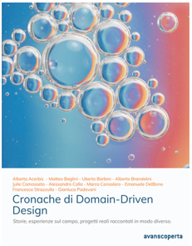


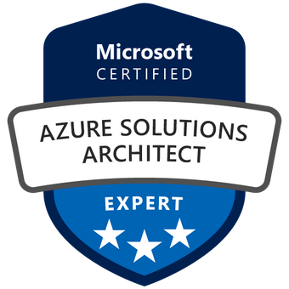

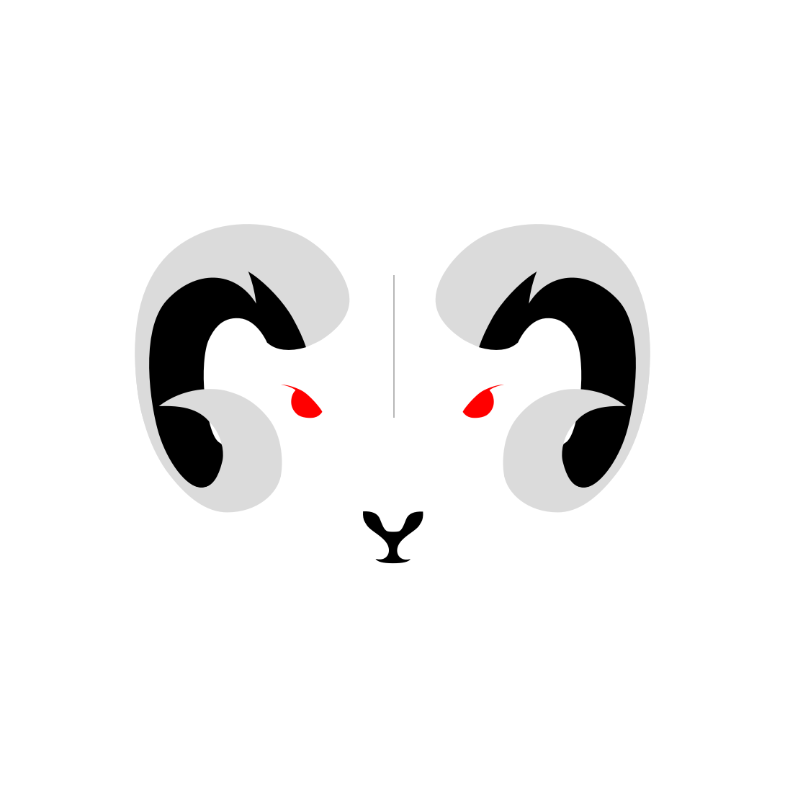

About Me
alberto.acerbis@intre.it
https://github.com/brewup
https://github.com/cqrs-muflone
https://github.com/ace68
https://www.twitch.tv/dddbrewup

